Slide 1

Computer Organization And Architecture
CSE-209
Lecture – 11
Al Bashir
Lecturer, Dept. of CSE
Dhaka International University

Slide 2
Content
Floating-point Representation

Slide 3
Floating-Point Representation
With a fixed-point notation (e.g., twos complement) it is possible to represent a range of positive and negative integers centered on 0.
This approach has limitations. Very large numbers cannot be represented, nor can very small fractions. Furthermore, the fractional part of the quotient in a division of two large numbers could be lost.

Slide 4
Floating-Point Representation
For decimal numbers, we get around this limitation by using scientific notation.
Thus, 976,000,000,000,000 can be represented as 9.76 X 10¹⁴ and 0.0000000000000976 can be represented as 9.76 X 10⁻¹⁴.
What we have done, in effect, is dynamically to slide the decimal point to a convenient location and use the exponent of 10 to keep track of that decimal point. This allows a range of very large and very small numbers to be represented with only a few digits.

Slide 5
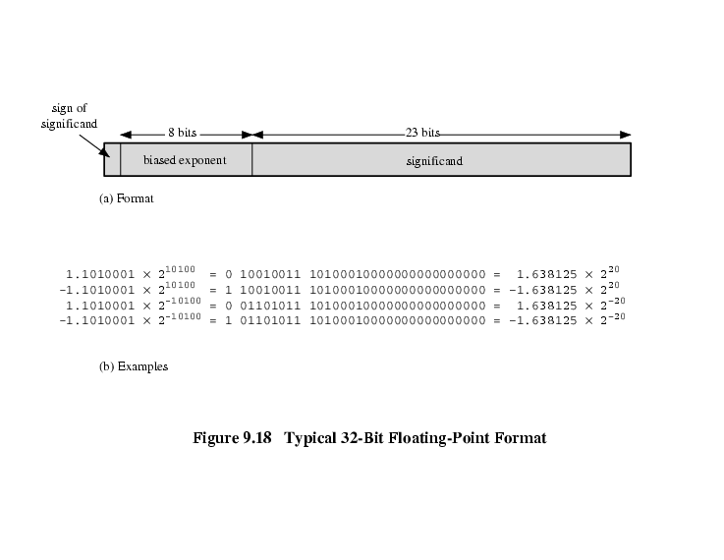

Floating-Point Representation
This same approach can be taken with binary numbers. We can represent a number in the form-
$±$S X B$±$^{E}

Slide 6
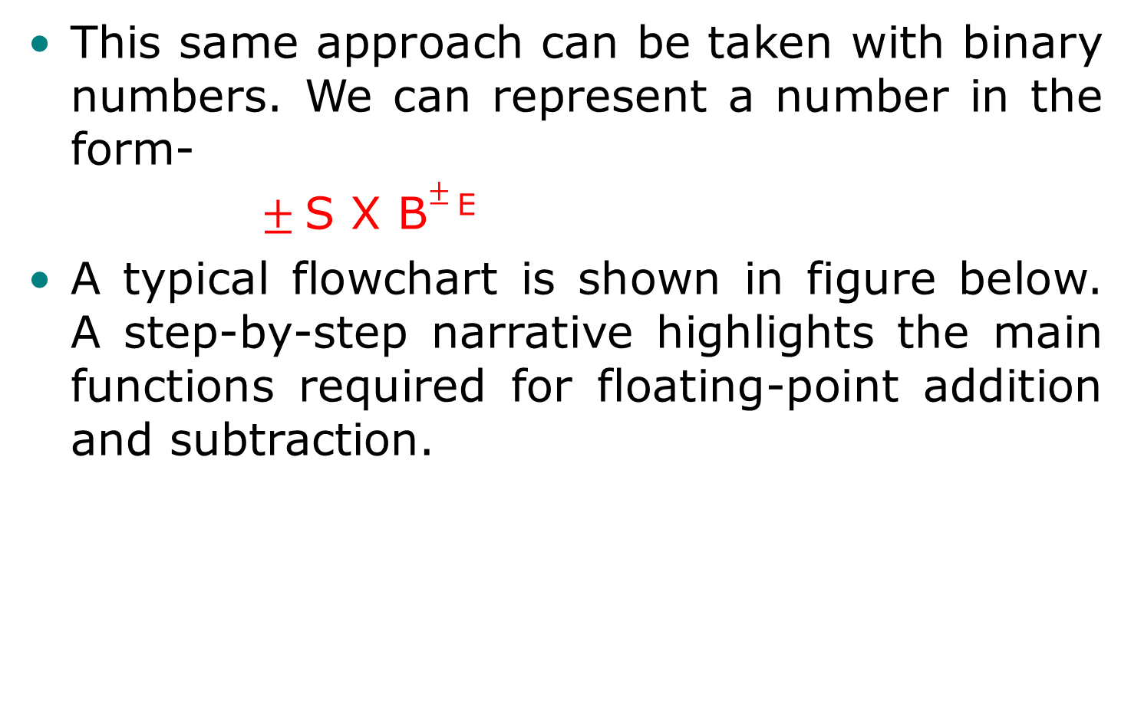
Floating-Point Representation
This same approach can be taken with binary numbers. We can represent a number in the form-
$±$S X B$±$^{E}
A typical flowchart is shown in figure below. A step-by-step narrative highlights the main functions required for floating-point addition and subtraction.

Slide 7
FP : Addition & Subtraction
For the addition or subtraction operation, the two operands must be transferred to registers that will be used by the ALU. If the floating-point format includes an implicit significant bit, that bit must be made explicit for the operation.
Phase 1: Zero check. Because addition and subtraction are identical except for a sign change, the process begins by changing the sign of the subtrahend if it is a subtract operation. Next, if either operand is 0, the other is reported as the result.

Slide 8
FP : Addition & Subtraction
Phase 2: Significant alignment. The next phase is to manipulate the numbers so that the two exponents are equal. Alignment may be achieved by shifting either the smaller number to the right (increasing its exponent) or shifting the larger number to the left.
Phase 3: Addition. Next, the two significant are added together, taking into account their signs. Because the signs may differ, the result may be 0.There is also the possibility of significant overflow by 1 digit.

Slide 9
FP : Addition & Subtraction
If so, the significant of the result is shifted right and the exponent is incremented. An exponent overflow could occur as a result; this would be reported and the operation halted.
Phase 4: Normalization. The final phase normalizes the result. Normalization consists of shifting significant digits left until the most significant digit (bit, or 4 bits for base-16 exponent) is nonzero. Each shift causes a decrement of the exponent and thus could cause an exponent underflow. Finally, the result must be rounded off and then reported.

Slide 10
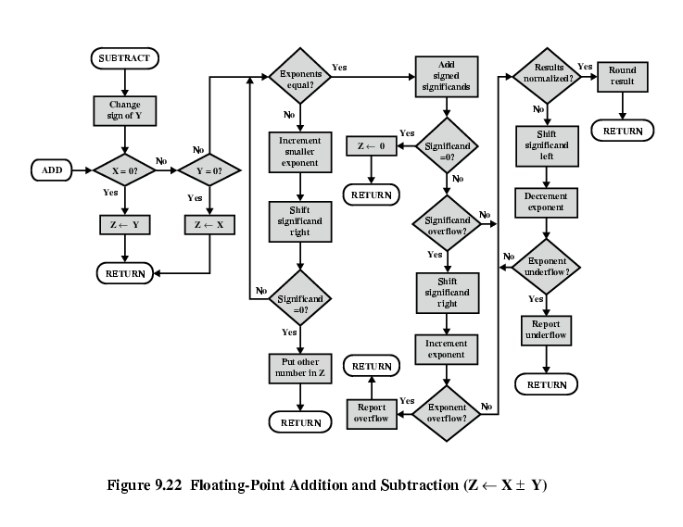
FP : Addition & Subtraction

Slide 11
FP : Addition & Subtraction
If so, the significant of the result is shifted right and the exponent is incremented. An exponent overflow could occur as a result; this would be reported and the operation halted.
Phase 4: Normalization. The final phase normalizes the result. Normalization consists of shifting significant digits left until the most significant digit (bit, or 4 bits for base-16 exponent) is nonzero. Each shift causes a decrement of the exponent and thus could cause an exponent underflow. Finally, the result must be rounded off and then reported.

Slide 12
FP : Multiplication & Division
Check for zero
Add/subtract exponents
Multiply/divide significands (watch sign)
Normalize
Round
All intermediate results should be in double length storage

Slide 13
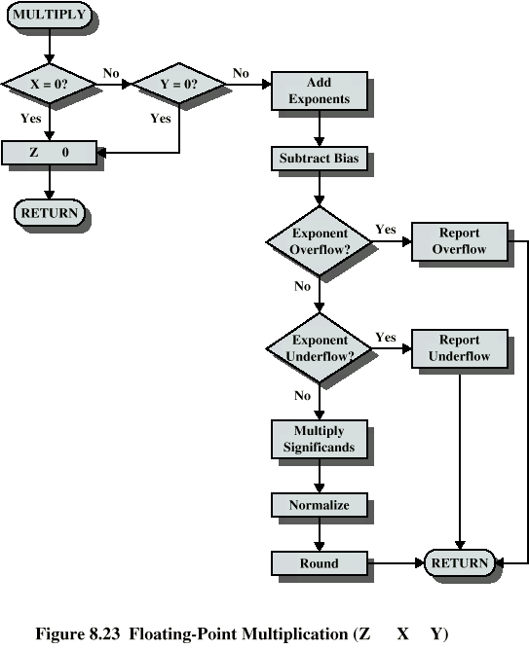
FP : Multiplication & Division

Slide 14
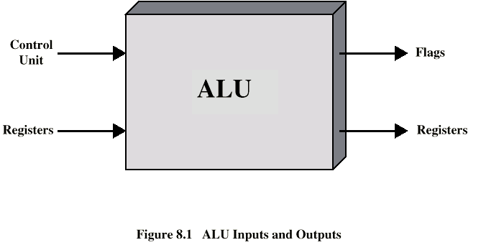
Arithmetic & Logic Unit
Data are presented to the ALU in registers, and the results of an operation are stored in registers.
These registers are temporary storage locations within the processor that are connected by signal paths to the ALU.
The ALU may also set flags as the result of an operation.

Slide 15
Integer Representation
In the binary number system,1 arbitrary numbers can be represented with just the digits 0 and 1, the minus sign, and the period, or radix point.
-1101.01012 = -13.312510
For purposes of computer storage and processing, however, we do not have the benefit of minus signs and periods. Only binary digits (0 and 1) may be used to represent numbers.

Slide 16
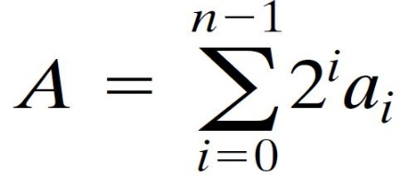
Integer Representation
An 8-bit word can represent the numbers from 0 to 255, including
00000000 = 0
00000001 = 1
00101001 = 41
10000000 = 128
11111111 = 255
In general, if an n-bit sequence of binary digits a_{n-1}, a_{n-2},…a₁, a₀ is interpreted as an unsigned integer A, its value is-

Slide 17
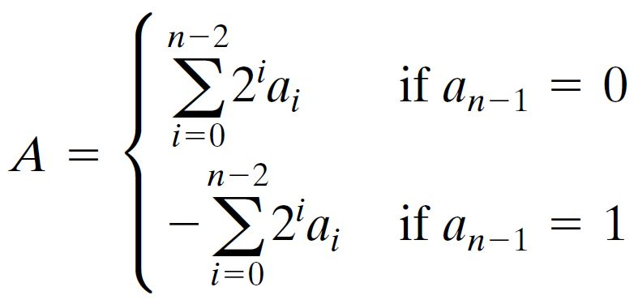
Sign-Magnitude
Left most bit is sign bit 0 means positive 1 means negative.
The simplest form of representation that employs a sign bit is the sign-magnitude representation. In an n-bit word, the rightmost n-1 bits hold the magnitude of the integer.
+18 = 00010010
-18 = 10010010
The general case can be expressed as above:

Slide 18
Sign-Magnitude
There are several drawbacks to sign-magnitude representation. One is that addition and subtraction require a consideration of both the signs of the numbers and their relative magnitudes to carry out the required operation.
Another drawback is that there are two representations of 0:
+ 010 = 00000000
-010 = 10000000 (sign magnitude)
This is inconvenient because it is slightly more difficult to test for 0 than if there were a single representation.

Slide 19
Two’s Compliment
Like sign magnitude, twos complement representation uses the most significant bit as a sign bit, making it easy to test whether an integer is positive or negative.
+3 = 00000011
+2 = 00000010
+1 = 00000001
+0 = 00000000
-1 = 11111111
-2 = 11111110
-3 = 11111101

Slide 20
Two’s Compliment : Benefit
One representation of zero
Arithmetic works easily (see later)
Negating is fairly easy
3 = 00000011
Boolean complement gives 11111100
Add 1 to LSB 11111101
+18 = 00010010 (twos complement, 8 bits)
+18 = 0000000000010010 (twos complement, 16 bits)
-18 = 11101110 (twos complement, 8 bits)
-32,658 = 1000000001101110 (twos complement, 16 bits)

Slide 21
Integer Arithmetic
In twos complement notation, the negation of an integer can be formed with the following rules:
Take the Boolean complement of each bit of the integer (including the sign bit).That is, set each 1 to 0 and each 0 to 1.
Treating the result as an unsigned binary integer, add 1.

Slide 22
Integer Arithmetic
+18 = 00010010 (2s comp.)
bitwise comp. = 11101101
+ 1
-------------------------------------------
11101110 = -18
As expected, the negative of the negative of that number is itself:
-18 = 11101110 (2s comp.)
bitwise comp. = 00010001
+ 1
--------------------------------------------
00010010 = +18

Slide 23
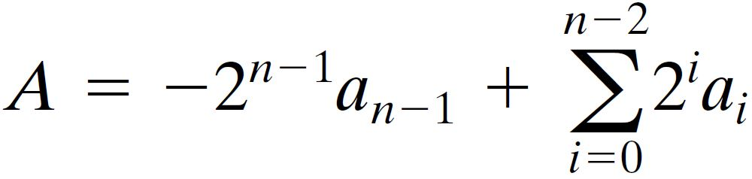
Integer Arithmetic
We can demonstrate the validity of the operation just described using the definition of the twos complement representation in Equation-

Slide 24
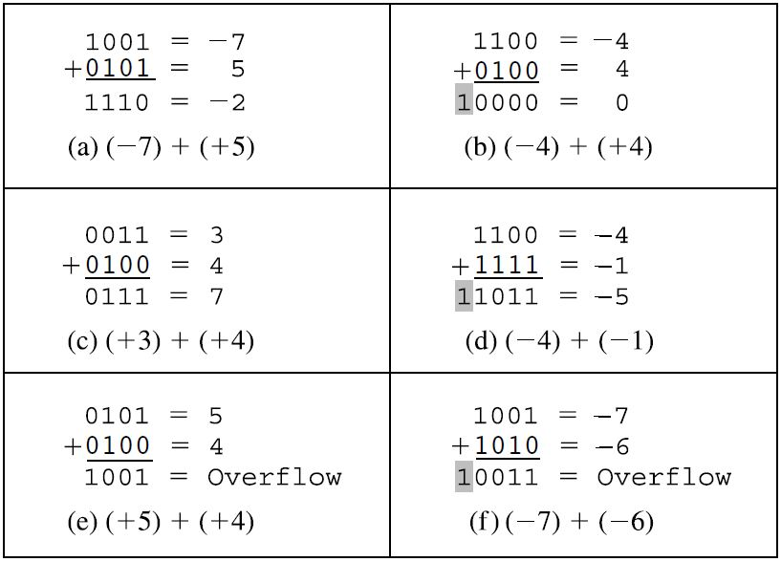
Addition and Subtraction

Slide 25
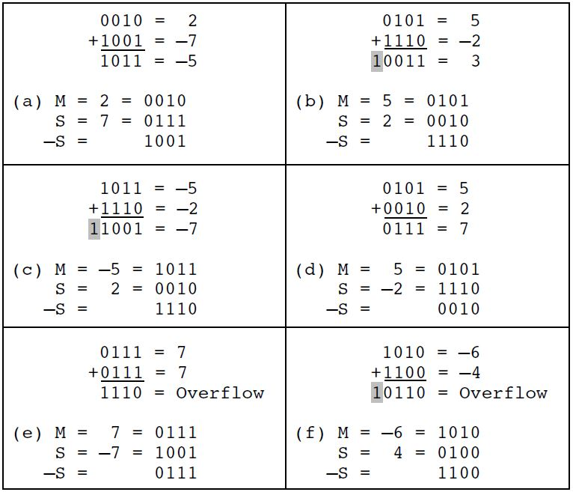
Addition and Subtraction

Slide 26
Multiplication
Several important observations can be made:
Multiplication involves the generation of partial products, one for each digit in the multiplier. These partial products are then summed to produce the final product.
The partial products are easily defined. When the multiplier bit is 0, the partial product is 0.When the multiplier is 1, the partial product is the multiplicand.
The total product is produced by summing the partial products. For this operation, each successive partial product is shifted one position to the left relative to the preceding partial product.

Slide 27
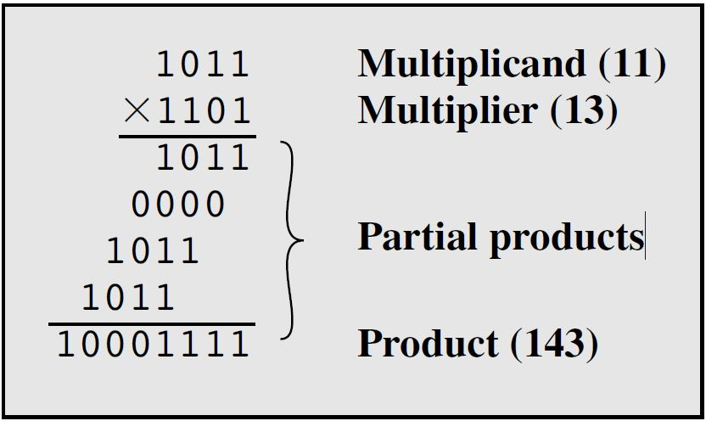
Multiplication
4. The multiplication of two n-bit binary integers results in a product of up to 2n bits in length (e.g.) 11 * 11 = 1001

Slide 28
Question??

Slide 29
Thanks

